Slide 1








OUT-CLEAN
OUT-GRAPH
OUT-ANALYZE
CONTESTANT PERFORMANCE
ANALYSIS
A
A FAN’S EXPLORATION OF THE ROLE OF GEOGRAPHY, AGE, AND PROFESSION IN CONTESTANT SUCCESS -
BY DOUGLAS KAPLAN

Slide 2

Overview:
OUT-CLEAN
OUT-GRAPH
OUT-ANALYZE
This analysis explores data from 705 different Survivor contestants across 44 seasons, focusing on how different factors like age, hometown, and profession influence their in-game performance.
I took two datasets, a Wikipedia one containing player traits such as age and home state, and combined it with another fan-created database focused on performance metrics such as Challenge Wins and Votes Cast Against in order to perform this analysis.

Slide 3


Methodology:
OUT-CLEAN
OUT-GRAPH
Imported a database of players and traits imported into excel from Wikipedia with a second database of players and performance metrics imported into excel from Survivor Fandom using Python.
Cleaned up and merged dataframes in Python.
Exported clean data into new CSV before importing into SQL.
Used SQL to perform general analysis of players traits and performance metrics.
Returned to Python to create visuals around SQL analysis findings.
Created new CSV of only winners in Python before importing all data into Tableau.
Created original Tableau Dashboard focused on statistical trends of winners.
Created Canva presentation showcasing analysis.
Upload project materials to Github and created Read Me.
OUT-ANALYZE

Slide 4

OUT-CLEAN
OUT-GRAPH
Data Cleaning:
OUT-ANALYZE
I cleaned several data inconsistencies:
The 'Finish #' column contained various labels such as 'Winner' and 'Runner-Up,' which were converted into numerical values to facilitate analysis.
Handling missing values in columns like "Votes For Bootee" and "Votes Against The Player."
Adjusting the format of non-numeric columns.
Handling of repeat winners
Handled genders utilizing AI. ChatGPT Prompt - “take this list of first names and create a new column of genders. Assign a male or female to any names you are 90% or more certain of gender, create a list at the bottom of names you are not sure about.”

Slide 5
Key Glossary Terms:
OUT-CLEAN
OUT-GRAPH
OUT-ANALYZE
Performance Metrics:
ChW: Challenge Wins. For tribal challenges, a contestant earns a fraction of 1 win, depending on if they participated (no points for sitting out). So in a five-person tribe's win, each participant gets (1/5) of a point, or 0.2 points. Duels at Redemption Island count as half a challenge (and half a win). Individual challenge wins count as a full point.
ChA: Challenge Appearances. Used to calculate ChW%. Fractional for tribal challenges (same as ChW), except sit-outs get charged for an appearance, because they could have participated.
ChW%: Challenge Win%. ChW% = ChW / ChA.
VFB: Votes For Bootee. The number of times the contestant has voted for the person who was ultimately voted out. Applies only to initial votes (no points for revotes in case of a tie).
VAP: Votes Against the Player. The total number of tribal council votes cast against the contestant. Only initial votes count (no penalty for revotes), and a hidden immunity idol (if played) erases the votes.
Survival Score (SurvSc). sum of Challenge Win% (ChW%) + Tribal Council% (TC%) + Jury Vote%, for a maximum possible score of 2 (3 after the finale).
Survival Average (SurvAv). sum of fractional Challenge Wins (ChW), weighted TC Ratio (wTCR), and (eventually) a weighted Jury%. The latter two max out at six points total, for a theoretical maximum score of around 18 or so.

Slide 6

OUT-CLEAN
OUT-GRAPH
Data Questions:
OUT-ANALYZE
How does geography affect contestant performance?
What professions tend to have the most success?
What age/gender group tends to perform best?

Slide 7


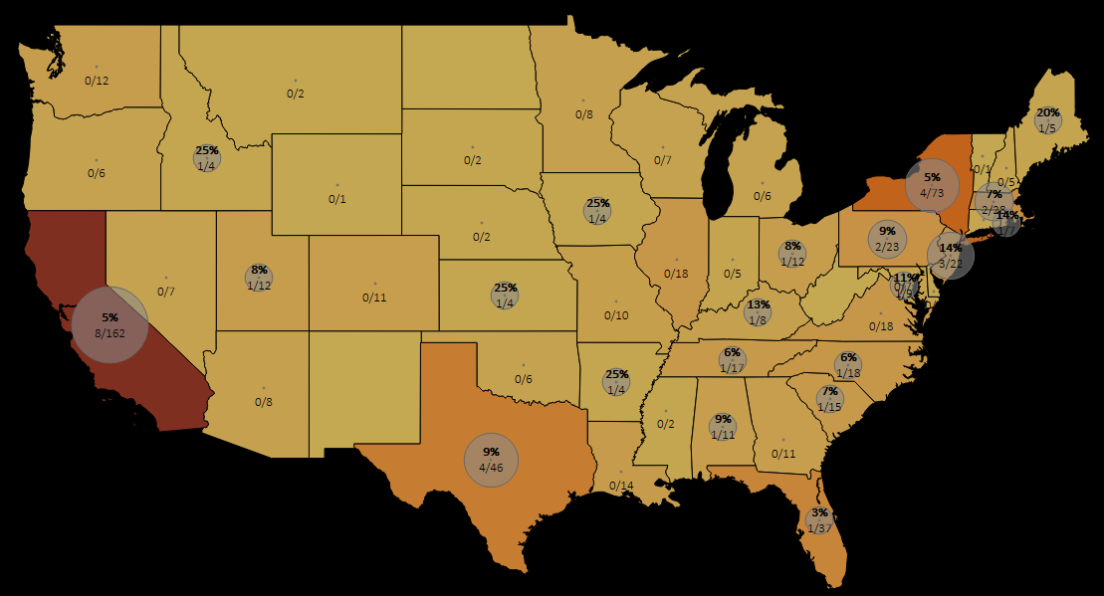
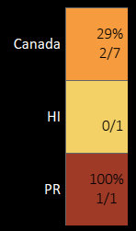
Geographic Analysis:
OUT-CLEAN
OUT-GRAPH
Contestants from certain states like California and New York appear more frequently in the top 3 finishers.
OUT-ANALYZE
Players from 23 different home states have won Survivor.
Puerto Rico is the only US territory to have a 100% win rate (Yam Yam Arocho, Season # 44).

Slide 8
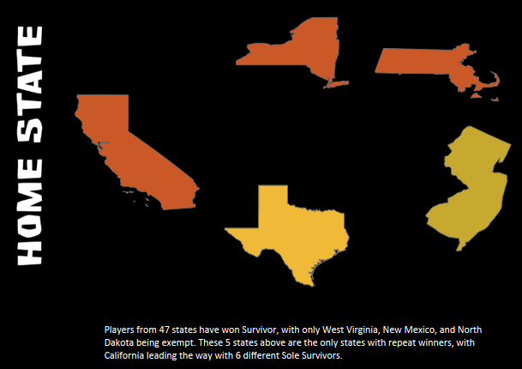
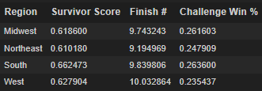
Geographic Analysis:
OUT-CLEAN
OUT-GRAPH
OUT-ANALYZE
When grouping players home towns by geographical region it became clear that Northeasterner’s typically finish better than Westerners.

Slide 9


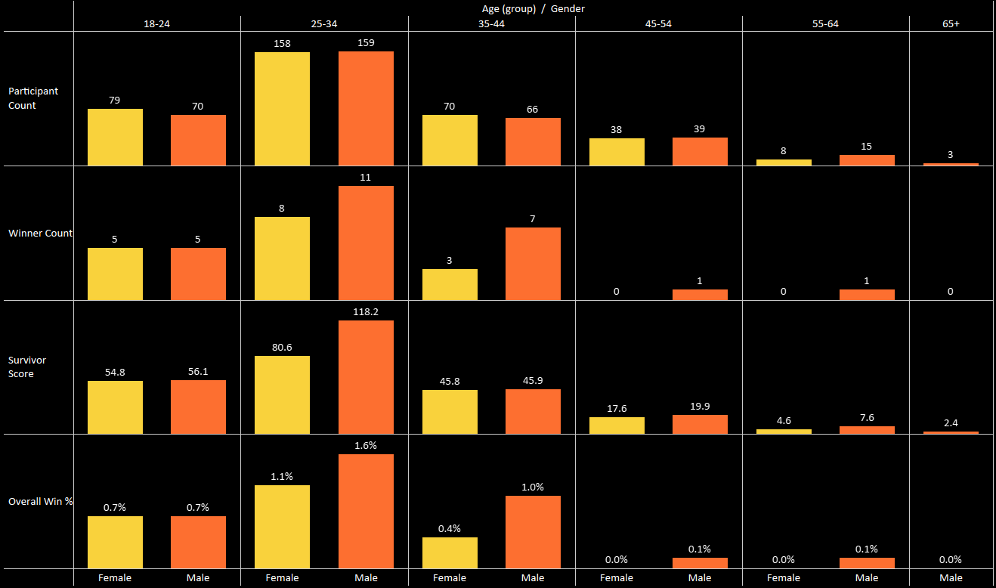
Age, Gender, and Performance:
OUT-CLEAN
OUT-GRAPH
OUT-ANALYZE
Male contestants generally have a higher "Survivor Score", win a higher percentage of challenges, and secure more challenge wins on average, while female contestants have a slightly higher average finish placement.
The 2nd youngest group (25-34) tends to have a higher "Survivor Score" and better average finish, while the oldest group (55-65) has lower challenge success and tend to be voted off earlier. The 65-65 age group does perform slightly better than the 45-55 age group.
Players aged 25 have won the most with 5 winners.

Slide 10
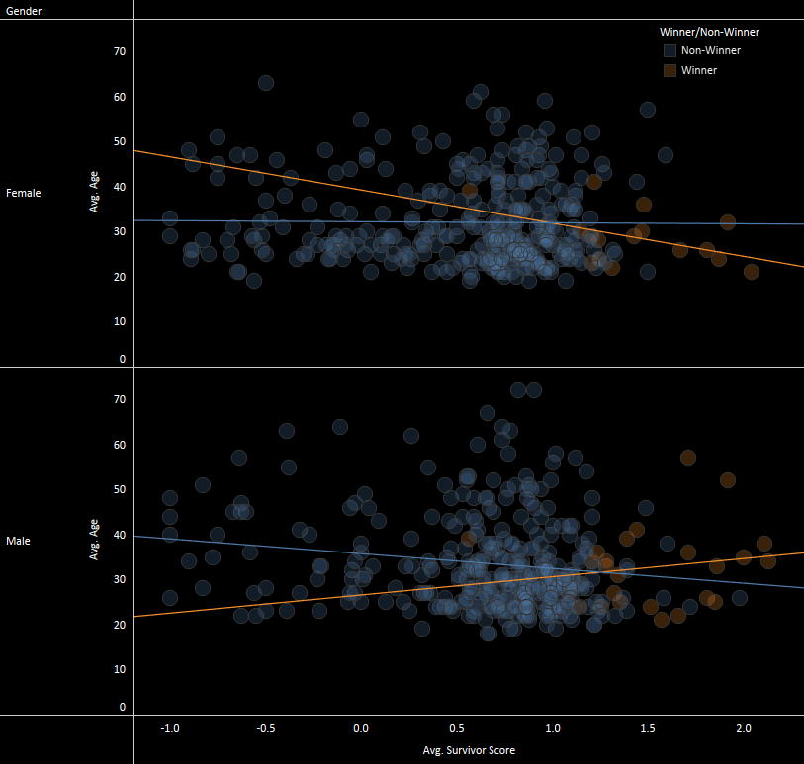
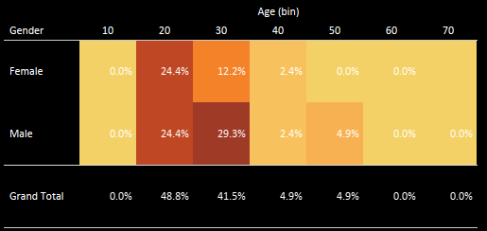
Age and Gender in Winners:
OUT-GRAPH
OUT-CLEAN
OUT-ANALYZE
If you are over aged 40 you probably shouldn’t even apply!
Players in their 20's win almost half of all seasons.

Slide 11


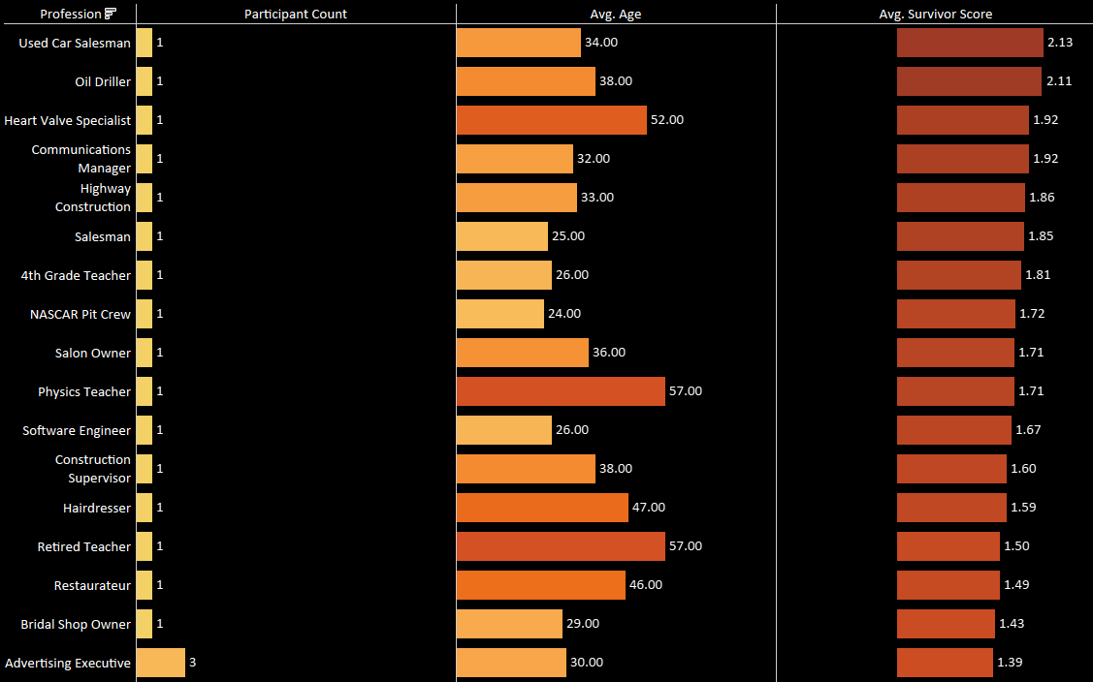
Professional Backgrounds
and Success:
OUT-CLEAN
OUT-GRAPH
OUT-ANALYZE
Contestants with leadership professions like corporate trainers or military backgrounds tend to perform better in tribal councils.
Teachers consistently placed in the top 10, while athletes had more variability in their placement.
Student, Bartender, and Attorney are the three most common professions of contestants.

Slide 12
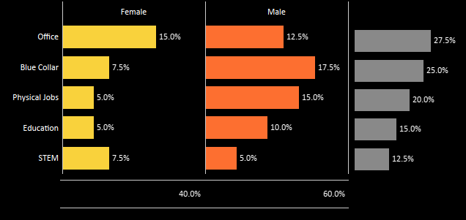
Professional Backgrounds
and Success:
OUT-CLEAN
OUT-GRAPH
OUT-ANALYZE
When grouping contestants professions into 5 main categories we see that players who work in offices win more frequently than those with physically demanding occupations.

Slide 13


OUT-CLEAN
OUT-GRAPH
Challenge Performance:
OUT-ANALYZE
I found that a contestant’s finish is highly dependent on a challenge performance. Contestants who won more than 30% of their challenges generally made it to the top 5.
No player has ever won Survivor without winning at least one challenge.

Slide 14

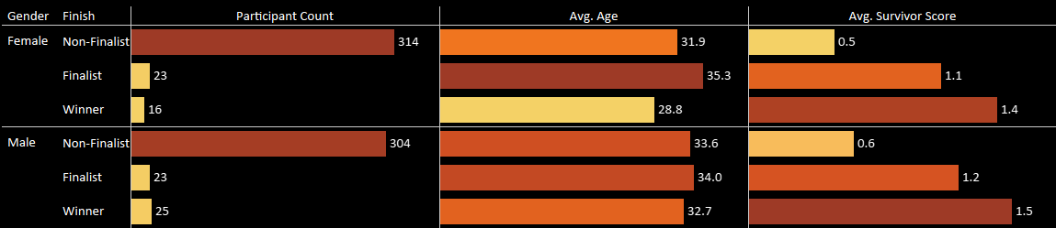
Key Findings:
OUT-CLEAN
OUT-GRAPH
States with higher populations produce more contestants. Being from an ‘outdoorsy’ state does not equate to better finish.
Players aged 25-35 consistently win at high rate.
Men win Survivor more than women, but participation in contestant is (almost) equal among genders.
Professions among contestants vary wildly but most seasons feature at least one Attorney and one Student. Having a physical job does not equate a better finish.
Consistent challenge performance is a strong predictor of final placement.
OUT-ANALYZE

Slide 15


Survivor Records:
Idols found/ played: Single-season
4
Rick Devens
S38: Edge of Extinction
Idols found/ played: Career
5
Russell Hantz
S19, S20, S22
OUT-CLEAN
OUT-GRAPH
OUT-ANALYZE

Slide 16


Survivor Records:
Advantages played: Single-season
3
Drea Wheeler
Survivor 42
Votes Against the Player (VAP): Single-season
19
Laura Morett
S27: Blood vs. Water
OUT-CLEAN
OUT-GRAPH
OUT-ANALYZE

Slide 17


Survivor Records, Challenge Stats:
Individual immunity wins: Single-season
5
Ozzy Lusth, S13; Tom Westman, S10; Terry Deitz, S12; Colby Donaldson, S2; Mike Holloway, S30; Brad Culpepper, S34
Individual immunity wins: Career
10
Boston Rob Mariano
S4, S8, S20, S22, S40
OUT-CLEAN
OUT-GRAPH
OUT-ANALYZE

Slide 18

Survivor Records, Challenge Stats:
Individual challenge wins: Single-season
8
Terry Deitz
S12: Panama
Individual challenge wins: Career
10
Boston Rob Mariano
S4, S8, S20, S22, S40
OUT-CLEAN
OUT-GRAPH
OUT-ANALYZE

Slide 19

Survivor Records, Tribal Council- Stat Leaders:
Times voted out: Single-season
3
Ozzy Lusth
S23: South Pacific
Times voted out: Career
5
Ozzy Lusth
S13, S16, S23, S34
OUT-CLEAN
OUT-GRAPH
OUT-ANALYZE

Slide 20


Survivor Records, Days Played Leaders:
Most total days played- Career
152
Boston Rob Mariano
S4, S8, S20, S22, S40
Most 'exile' days played - Career
36
Natalie Anderson
S29, S40
OUT-CLEAN
OUT-GRAPH
OUT-ANALYZE

Slide 21


Survivor Records, Statistical Favorites:
Survival average (SurvAv): Single-season
17.81
Tom Westman
S10: Palau
Survival score (SurvSc): Single-season
2.26
J.T. Thomas
S18: Tocantins
OUT-CLEAN
OUT-GRAPH
OUT-ANALYZE

Slide 22


OUT-CLEAN
OUT-GRAPH
Conclusion & Future Work:
OUT-ANALYZE
This analysis provides insights into the diverse factors influencing a contestant’s finish on Survivor. Future work could expand on this by including more seasons, expanding performance metrics, incorporating a state population dataset, or analyzing how Survivor has changed throughout the years.
Click Here For Additional Visualizations

Slide 23

OUT-CLEAN
OUT-GRAPH
References & software:
OUT-ANALYZE
Tools : Python, Excel, SQL, Tableau, Canva, ChatGPT, Google Sites, Github
Data Sources: Wikipedia, TrueDorkTimes, & Survivor Fandom
Image Sources: CBS Pictures

Slide 24

OUT-CLEAN
OUT-GRAPH
Contact Me:
OUT-ANALYZE
Thank you very much for your time!
Douglas Kaplan
5087 Kittrell Rd,
Nashville, TN, 37221
Douglasjkaplan@gmail.com
615-418-2639
https://github.com/Dkaplan8
https://www.linkedin.com/in/douglas-kaplan/

